Slide 1
Kafka’s The Metamorphosis
A Timeless Tale of Transformation- an existential allegory of human isolation

Slide 2
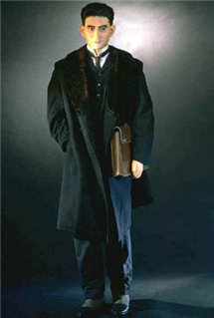
People are sewn into their skins for life and cannot
alter any of their seams, at least not by their own hands.
How are Gregor Samsa and Franz Kafka alike? How are they different?

Slide 3
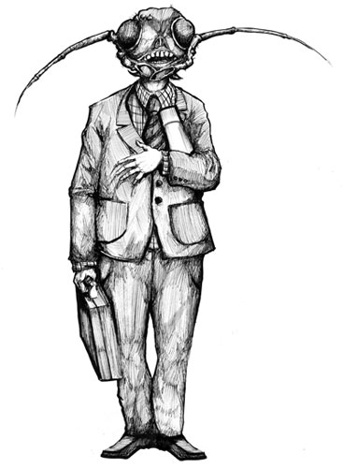
Cast of Characters
Gregor- A traveling salesman and the protagonist of the story. He hates his job but keeps it because of his duty to his family.
What does Gregor KEEP and what does he LOSE throughout the story?
What do you think is Gregor’s greatest struggle?

Slide 4
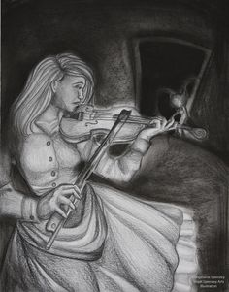
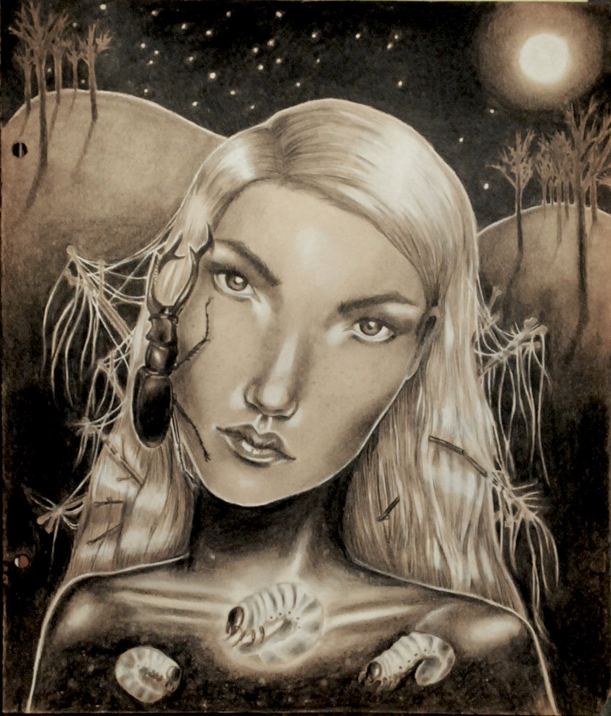
Cast of Characters
Grete Samsa- Gregor’s sister. A young woman on the edge of adulthood. She shows great concern at the beginning, but her compassion fades.
How does Grete undergo her own metamorphosis?
How is she somewhat responsible for Gregor’s death?

Slide 5
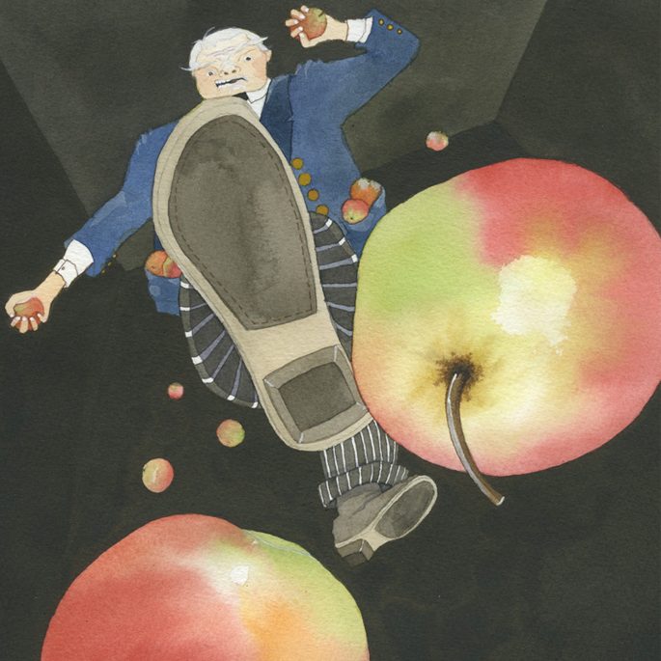
Cast of Characters
Mr. Samsa- His business failure has left him exhausted and emotionally broken. He shows hostility and impatience toward Gregor.
Why do you think Mr. Samsa is so hostile toward Gregor?
How has Mr. Samsa’s failure affected Gregor’s situation?

Slide 6
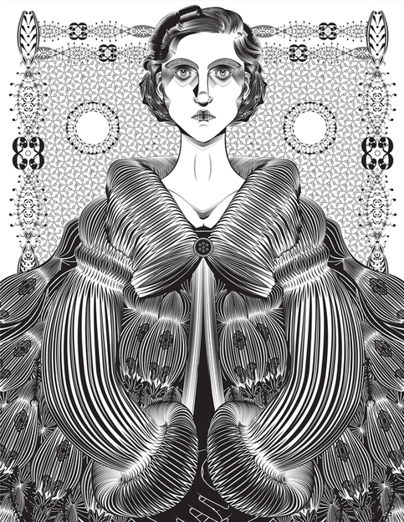
Cast of Characters
Mrs. Samsa- Frail and distressed, she is torn between her love for Gregor and her horror of him. She is protected from the full reality of Gregor’s transformation.
How does the mother contribute to the family dysfunction?
Is the mother part of the transformation? How so?

Slide 7
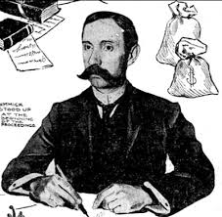
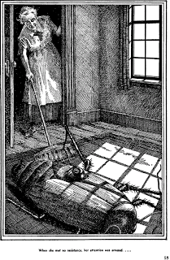
Minor Characters
Charwoman- An elderly widow who is also the Samsa’s cleaning lady. She is no-nonsense and honest as she faces Gregor’s state without fear or disgust.
Chief Clerk is distrustful and overbearing. He hints that Gregor is a slacker at work. He flees in terror!

Slide 8
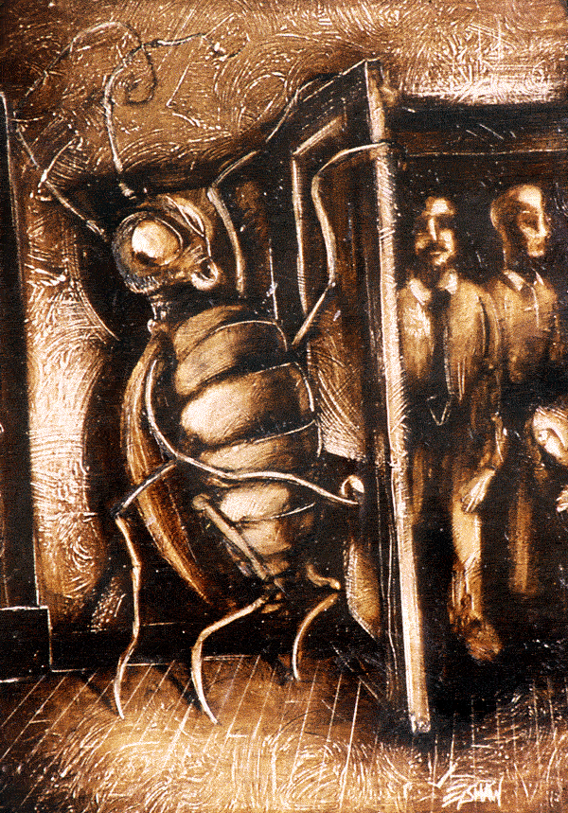
Minor Characters
The Boarders- three temporary boarders who pay room and board to the Samsas. They value order and cleanliness, so they are horrified when they discover Gregor.
What symbolic meaning do the boarders hold?
Are the boarders a CAUSE or an EFFECT? How so?

Slide 9
Literature and Life
Humans crave meaning
A universe that makes sense
Stories are created to make sense out of the universe; but when the universe doesn’t cooperate you feel like a stranger in the world

Slide 10
Terms to help you think deeply about Kafka
Absurdity/Absurdism
Alienation
Authoritarian
Chaos
Existence/Existential
Humanity
Incomprehensibility
Surrealism

Slide 11
Literary Elements & Devices
Allegory= a story in which the characters and events are symbols that stand for ideas about human life or for a political or historical situation
Foreshadowing= to give a hint of something that has not yet happened
Motif= an important repeated pattern in a story
Metaphor= a form of comparison that suggests a non-lieral similarity
Symbols= an idea or thing that stands for something else

Slide 12
Some Big Ideas
The world is not a place of certainty and the ideal is unrealizable
Love is not enough
There are limitations that come from being human:
How one interprets the world
The systems society imposes
Human relationships
The shifting sense of identity

Slide 13
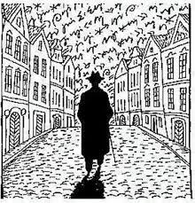
Think deeply about Kafka & The Metamorphosis
…constantly seeing new faces, no relationships that last or get more intimate.
I cannot make you understand. I cannot make anyone understand what is happening inside me. I cannot even explain it to myself.
Alienation

Slide 14
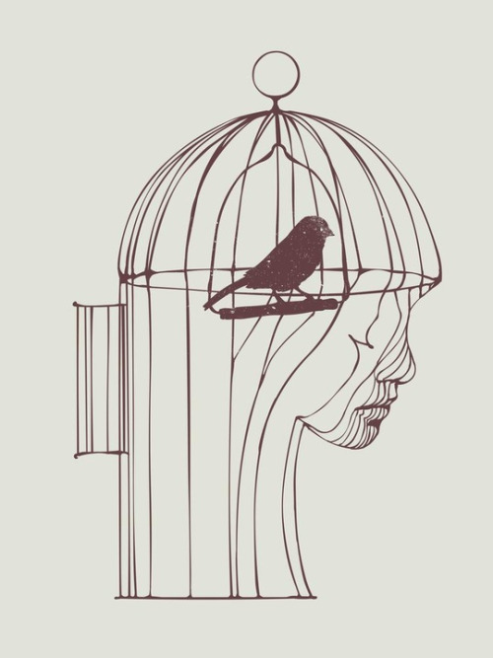
Think deeply about Kafka & The Metamorphosis
Absurdity- a universe that functions without any governing system of order & justice.
The story has a strong overtone of absurdity; it suggests chaos in a world without rules
Conflict between the human tendency to look for meaning in life and the inability to find any meaning

Slide 15
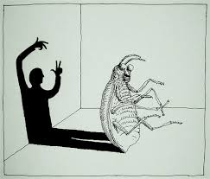
Think About It...
Gregor’s changes throughout
How & WHY Gregor transforms. Why doesn’t the reader know?
Why does Gregor retain some human qualities? What’s the message here?
What role does FATE play in Gregor’s life?
Notes:
Despite the physical transformation into an insect at the beginning of the story, Gregor changes very little throughout
The reader never learns HOW or WHY Gregor transformed. The story focuses on the CONSEQUENCES of his transformation.

Slide 16
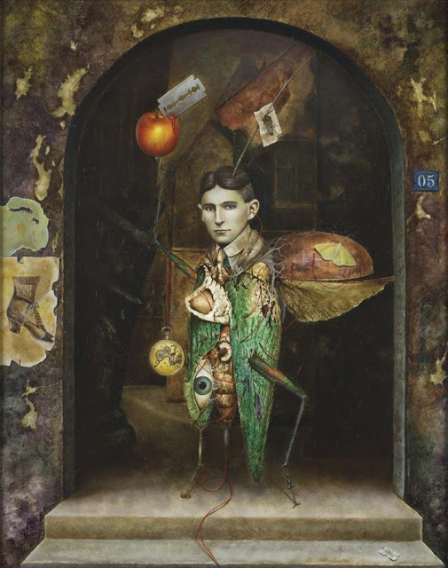
Think deeply about Kafka & The Metamorphosis
Surrealism
Reaction against rationalism/logic
Designed to purposely cause surprise through unexpected overlaps and things that do not follow logically
Seeks to free the imagination from control of reason

Slide 17
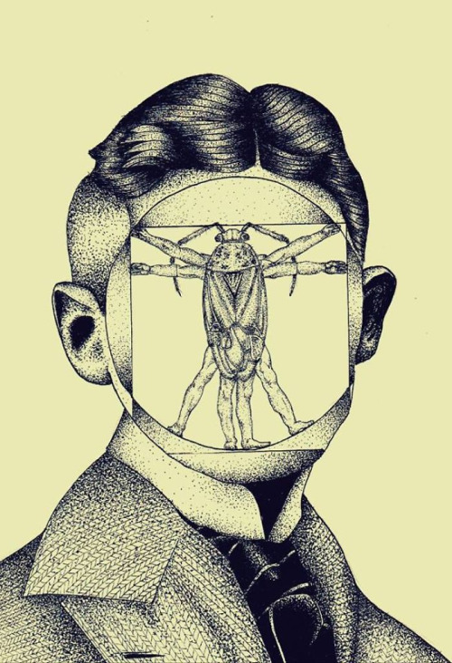
Existentialism is...
A complex philosophy emphasizing the existence of the human being, the lack of meaning and purpose in life, and the solitude of human existence

Slide 18
Existentialism (Popular during the 19th century)
Mankind has free will.
Life is a series of choices, creating stress.
Few decisions are without any negative consequences.
Some things are irrational or absurd, without explanation.
If one makes a decision, he or she must follow through.

Slide 19
Some Themes
The T
The disconnect between mind & body
The absurdity of life
Personal identity
Alienation Family Duty Freedom
The limits of sympathy
Money’s effects on relationships

Slide 20
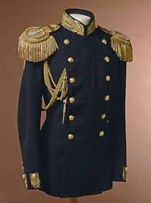
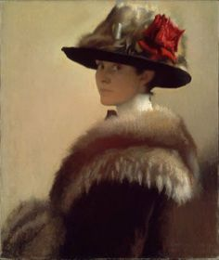
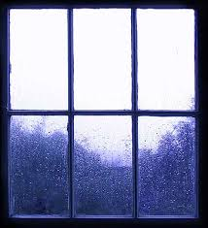
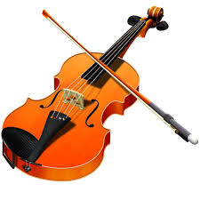
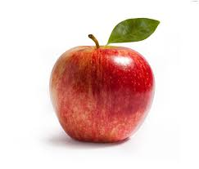
Some Symbols

Slide 21
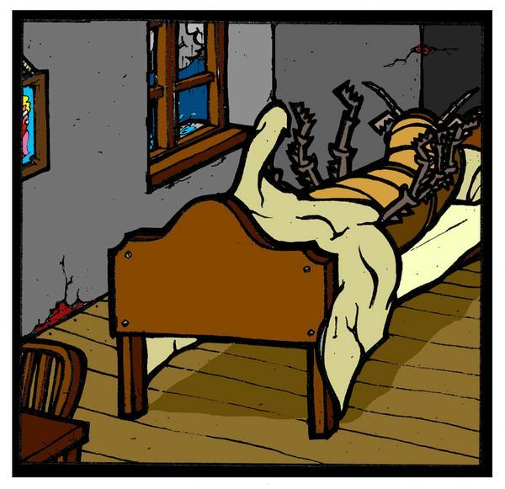
Think About It...
Gregor has such a passive adaptation to the massive change he undergoes
“One morning, when Gregor Samsa woke from troubled dreams, he found himself transformed in his bed into a horrible vermin”.
Why does he accept this fate so easily?
Why doesn’t he fight back?

Slide 22
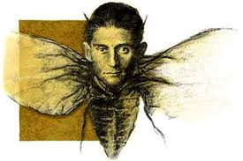
Think About It...
The parallels between Kafka’s and Gregor’s life:
Relationship with father
Trapped in a world he felt he didn’t belong
Alienated & isolated
Similar names (Kafka/Samsa)
“Samsa” comes from the Czech words Sa’m (alone) and Jsem (I am)
Samsa= I am alone
Both had jobs they didn’t enjoy
Both were very close to their sisters and were hurt by their sisters

Slide 23
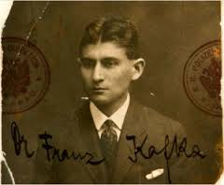
I am free and that is why I am lost.
Franz Kafka

