Slide 1
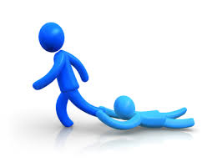
Exam Review
Clauses: Independent/ Dependent
Can stand by itself as a simple sentence ( S + V)
Cannot stand by itself but provides IC with additional information

Slide 2
Practice (I vs. D)
The pony express did not last long.
Mail was carried by ships.
Because today’s mail travels so slowly.
While they were called pony boys.
When they carried mail.
Because fuel is so expensive.
A rider traveled a great distance before stopping at night.
Riding on the pony express could be fun.
Notice any SUBORDINATE CONJUNCTIONS? (AAAWWUBBIS) https://quizlet.com/32928158/flashcards

Slide 3
Verbs
ACTION
https://www.youtube.com/watch?v=ldoAQtUp02A
LINKING= a state of BEING. They LINK the subject to a word or phrase in the predicate.
The bamboo forest seems
magical at sunset
IS ARE WAS WERE AM BE BECOME BEEN BEING

Slide 4
Practice ACTION vs. LINKING
William is excited about his promotion.
Margot drives a Ford Mustang.
I believe in unicorns.
She appears upset about the announcement.
The eggs smell rotten.
The chicken strutted across the road.
He went red after tripping on the rug.
Your plans for the wedding sound nice.
You look exhausted after studying all night.

Slide 5
CONJUNCTIONS
For
And
Nor
But
Or
Yet
So
A
A
A
W
W
U
B B I S
Coordinating- connects words, phrases, & clauses
Subordinating- joins 2 clauses and cannot stand alone

Slide 6
Practice
Until Mr. Sanchez has his first cup of coffee in the morning, he is a grouch.
After Amy sneezed all over the tuna salad, everyone got grossed out.
Rocky terrorizes the poodles next door yet adores the German shepherd across the street.
The bowl of squid eyeball stew is hot and delicious.
Nina preferred to read but Danny likes to watch TV.
I didn’t know which job I wanted so I decided to wait.
While the rain fell, the woman waited beneath the awning for the bus.

Slide 7
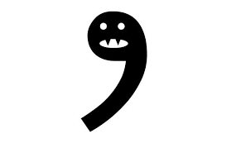
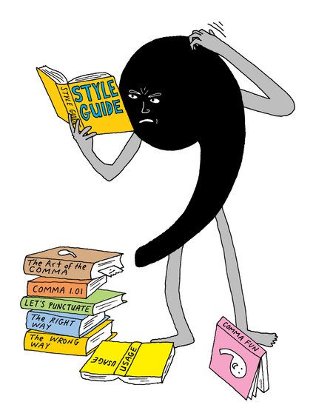
The Almighty Comma
http://www.chompchomp.com/rules/csfsrules.htm
Separate independent clauses
After an introductory clause or phrase
Between items in a series
To enclose clauses NOT essential to the meaning

Slide 8
Comma Practice
http://www.chompchomp.com/hotpotatoes/commas01.htm
https://depts.dyc.edu/learningcenter/owl/exercises/comma_placement_ex1.htm

Slide 9
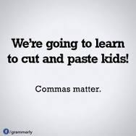
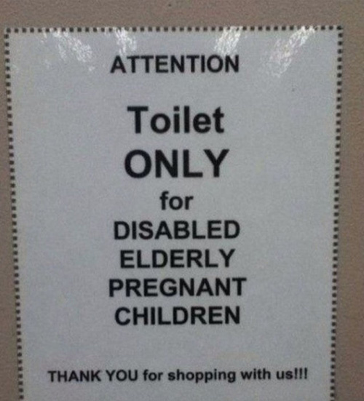
Little Things Make a Big Difference

Slide 10
The Almighty Comma

Slide 11
Comma Splices and Fused Sentences
Main Clause + Ø + Main Clause
Main Clause + , + Main Clause
Make two complete sentences
Use a comma and a FANBOY
Use a semicolon
Use a Subordinating Conjunction
Fix-Ups
http://www.chompchomp.com/csfs05/csfs05.htm

Slide 12
Prepositions
https://www.youtube.com/watch?v=xyMrLQ4ZI-4
A preposition describes a relationship between other words in a sentence.
We use prepositions more than any other word in the English language.
Hard to DEFINE. WE use our hands to describe them!

Slide 13
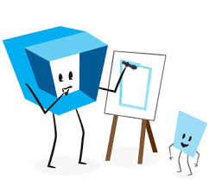
Review Review Review Review Review
Adjectives describe nouns by answering one of these three questions: What kind is it? How many are there? Which one is it? An adjective can be a single word, a phrase, or a clause.
https://www.youtube.com/watch?v=Box4Clu1-1k

Slide 14
WORD POWER
Ver= Truth
Scend= To climb
Mag= Greatly generous
-id= pertaining to

